Slide 1



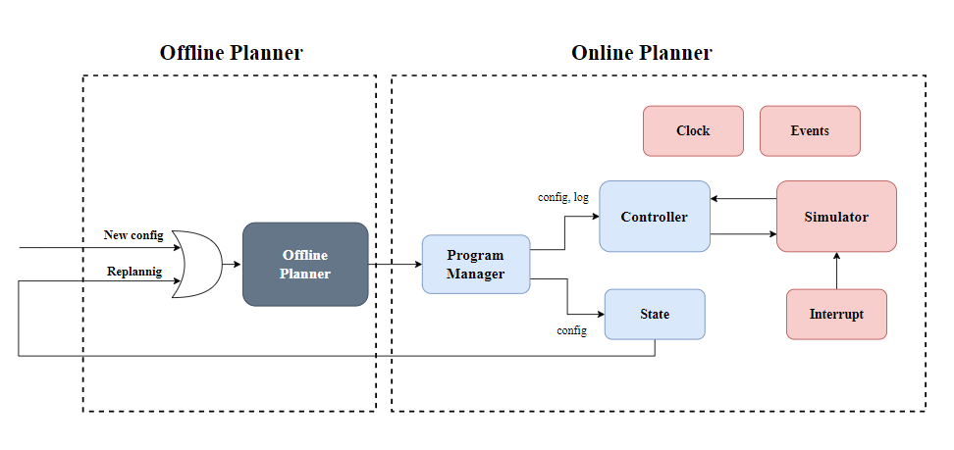
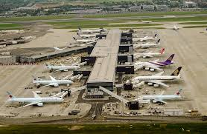
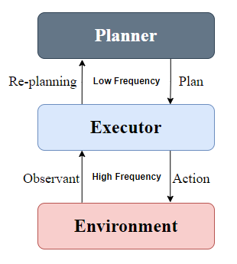
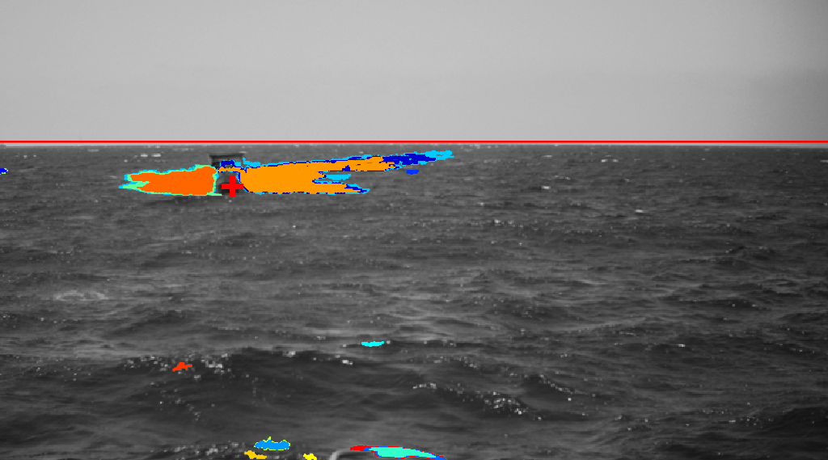
Online Algorithm for Management Takeoffs and Landings
Yoav Cohen and Hodaya Cohen-Adiv, Supervised by Ayal Taitler
Introduction
Block Diagram
Results
An Airport has a lot of operations everyday.
Multiple planes that are simultaneously take off and land.
Operations that depends on other operations.
Unexpected problems create conflicts and may change the day plan.
Airport management is done with a day plan and executing it in REAL TIME.
Hough transform based solution
Accurate and consistent horizon detection
Adaptive thresholds help in handling varying environmental conditions, such as sun glare
Airport
Project Goal
ROI Detection
Creating an online Algorithm for managing takeoffs and landings
Our algorithm ran the offline plan while dealing with real-time malfunctions and changes.
The algorithm must decide whether the program can run with the different constraints or whether re-planning is needed.
Input Frame and Object Tracking
Determine Threshold Increment
Extract MSER Regions
ROI
Choose Closest
Region
Challenges
Maximally Stable Extremal Regions (MSER) is an efficient feature extraction algorithm
Suggested in [Matas et al., 2004]
Thresholds the image under a sequence of increasing threshold values and looks for stable connected components
Stable connected components are those whose area remains unchanged over a certain number of thresholds
General Schema
Future Work
Add more types of interrupts to simulate a more realistic world in a simulation.
Add a GUI - Make the system inactive to the user with which he will be able to track the planes and lanes in real-time.
The Planner is the Offline Algorithm.
The Executor is the Online Algorithm.
The Environment is the testing environment that simulates an airport with interrupts in real-time.
MSER regions for a frame of a sailboat. The coordinates supplied by the tracker are marked as a red cross.
The ROI is chosen to be the region closest to the tracker

